Slide 1
Minecraft-Inspired Exploration
Electrifying the Future 2024

Slide 2
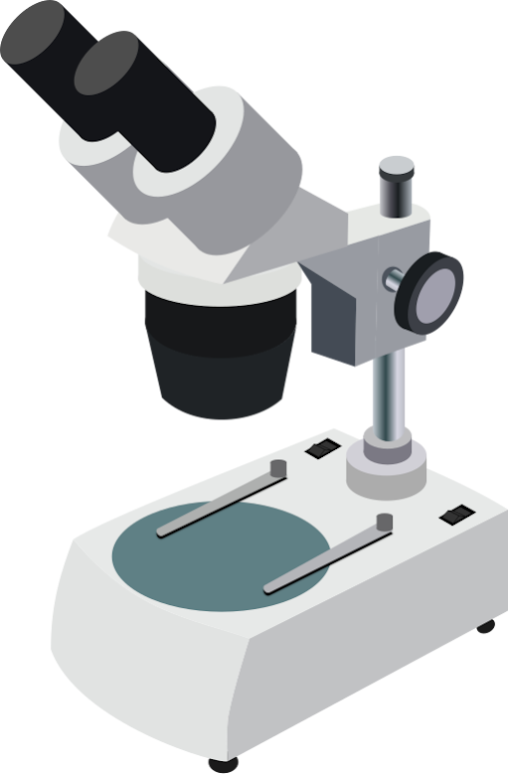
What is a geologist?

Slide 3
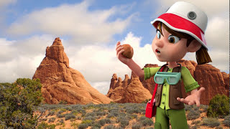
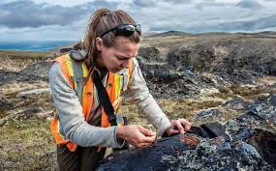
A geologist is a scientist who studies the Earth, including rocks, minerals, and fossils, to learn how our planet was formed and how it changes over time.
They help find resources like minerals, oil, and water, and they also work to predict natural disasters like earthquakes and volcanoes.
Geologists often explore the outdoors, digging and discovering new things about the Earth!
Click here!
https://youtu.be/t7bho2bDG2k?si=iT-hH1N-JfZcC9MM
https://theteenagertoday.com/i-want-to-be-a-geologist/

Slide 4
What is Geology?

Slide 5
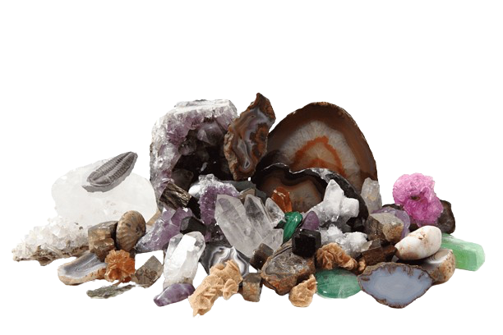
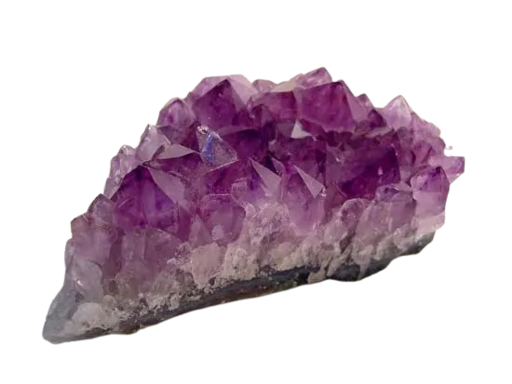
Geology is the study of our planet’s rocks, minerals, soils and how they move, interact with one another and evolve through millions of years.
Rocks are made up of minerals. Each rock and mineral tells a story about Earth’s history.
Geology helps us find resources like water, oil. minerals and metals that have become very important in our lives.
Geology helps us understand natural events like earthquakes and volcanoes.
Mining helps us with Geology! Mining is the process of removing and isolating the minerals that we need to build items that we use every day and to create new advanced technologies such as batteries and electric vehicles.
https://www.pngegg.com/en/search?q=rocks++++Minerals
https://kids.britannica.com/students/article/mineral/275853

Slide 6
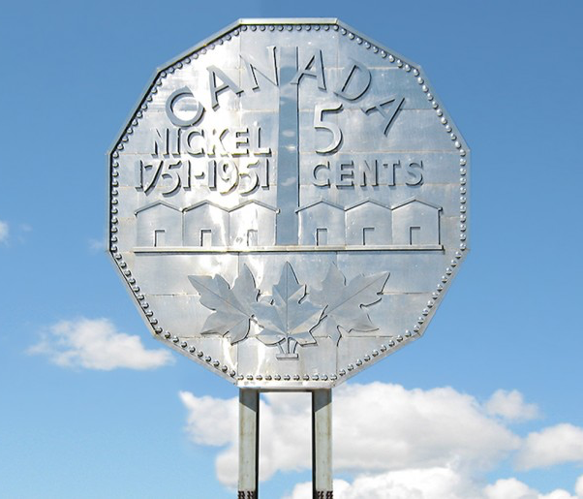
Do we have geology/mining in Sudbury Ontario?
Yes! Sudbury is home to the world's largest mining complex.
In Sudbury, we mine very important minerals, what are they?
A long time ago, a huge meteorite hit Sudbury, and it melted the rock. When the rock cooled down, a lot of metals like Copper and Nickel were concentrated and easy to extract.
That's why Sudbury is known for having a lot of nickel and copper. These minerals are important!
https://www.bankofcanadamuseum.ca/2014/11/the-big-nickel/
Notes:
What are they?
Answer: Copper and Nickel
This focuses on two of some of the most mined minerals in sudbury that have great value. We do mine other minerals, however we are focussing on Copper and Nickel.

Slide 7
How are Copper and Nickel important to the
automotive industry?
Nickel:
Electric cars
Key component in the battery
The nickel is used in lithium batteries
This helps to save electricity better
Copper:
Used in electrical wires
Copper is good at carrying electricity
They are found all throughout cars
Also, in the motor of these cars!

Slide 8
What rocks and minerals do we see in minecraft?
Today you will look at some of these minerals!
Copper
Iron
Coal
Quartz
Amethyst
Lapis Lazuli

